Slide 1
Music Recommendation system using AI
RA2011026010087 – VINJAM NITHIN
RA2011026010081 –HIMESH CHANDER ADDIGA
RA2011026010079 –HARSHITH B

Slide 2
Tables of contents
Problem Statement
Literature Review
Limitations with citations
Objective
Proposed Methodology
Architecture Diagram
Modules Description
References

Slide 3
Problem Statement
Design an AI-powered music recommendation system that can recommend songs or playlists to users based on their music preferences, listening history, and user behavior. The system should be able to analyze the audio features of songs such as tempo, genre, mood, rhythm, and beats per minute to provide personalized recommendations that match the user's preferences. Additionally, the system should consider the user's demographic information, location, and time of day to provide contextually relevant recommendations. The system should be able to learn and adapt to the user's changing preferences and continuously improve the accuracy of the recommendations. The goal is to enhance the user's music discovery experience and increase engagement with the music streaming platform.

Slide 4
Literature Review
"A Survey of Music Recommendation Systems" by G. Adomavicius and Y. Kwon (2007): This survey paper provides an overview of different types of music recommendation systems, including content-based, collaborative filtering, and hybrid systems. It also discusses the evaluation metrics used to assess the performance of these systems.
"Collaborative Filtering for Music Recommendation with a Social Dimension" by J. Schedl et al. (2016): This paper proposes a music recommendation system that incorporates social features, such as user profiles and social networks, into the collaborative filtering algorithm. The system was evaluated using a dataset of over 1 million songs and 3 million user ratings.
"Deep Learning for Music Recommendation: Challenges and Opportunities" by F. A. Gers and J. Schmidhuber (2001): This paper discusses the use of deep learning techniques, such as neural networks and recurrent neural networks, for music recommendation. The authors describe the challenges of using these techniques for music data, such as the variability of music genres and the lack of standardized metadata.

Slide 5
LIMITATIONS WITH CITATIONS:
Limitations:
Cold-start problem: New users or items may not have enough data available for the system to generate accurate recommendations, leading to the cold-start problem.
Data sparsity: Music recommendation systems rely on user data to generate recommendations, and sparse data can limit the accuracy of recommendations.
Lack of diversity: Some recommendation systems may recommend the same popular songs or artists to all users, leading to a lack of diversity in the recommendations.
Citations:
1.Personalized music recommendation using deep learning based on user's implicit feedback.
2. An adaptive music recommendation system with long and short-term preferences.

Slide 6
OBJECTIVE
The objective of a music recommendation system using artificial intelligence is to provide personalized and relevant music recommendations to users based on their listening history, preferences, and other factors such as location and time of day. The system uses machine learning and data mining techniques to analyze user data and generate recommendations that are tailored to each individual user. The goal is to enhance the user's music listening experience by introducing them to new and interesting music that they may not have discovered on their own. Additionally, a music recommendation system using artificial intelligence aims to address the challenges and limitations of traditional music recommendation systems by incorporating advanced algorithms and techniques that can improve the accuracy and diversity of the recommendations.

Slide 7
PROPOSED METHODOLOGY
We will be using collaborative filtering in our project. Using information about users similarities to other users, collaborative filtering makes predictions about what users would enjoy. The system gathers user past activity, such as user ratings of music tracks, likes, or how long the user was listening to the tune, in order to identify similar users. collaborative filtering doesn’t take into account any of the information about the music or sound itself. Instead, it analyzes user preferences and behavior and by matching one user to another predicts the likelihood of a user liking a song. For example, if User A and User B liked the same song in the past, it is likely that their preferences match. In the future, User A might get song recommendations that User B is listening to based on the similarity that was established earlier. In collaborative filtering, several approaches are used such as user-based and item-based filtering. User-based filtering establishes the similarity between users. User A is similar to User B so they might like the same music. Item-based filtering establishes the similarity between items based on how users interacted with the items. Item A can be considered similar to Item B because they were both rated 5 out of 10 by users.

Slide 8
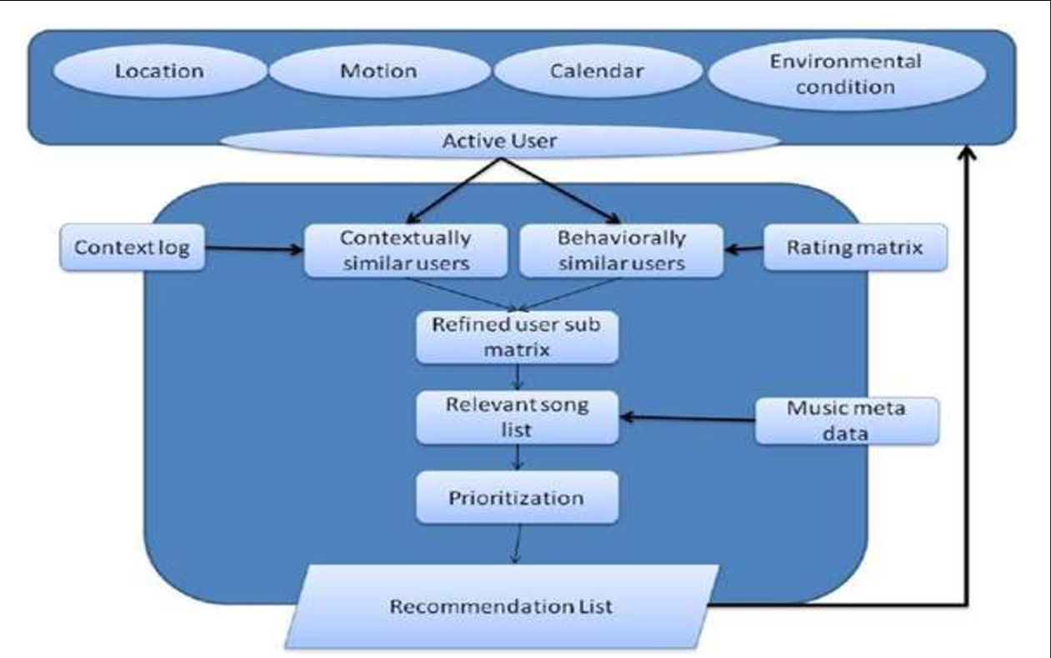
Architecture

Slide 9
Modules
Data Collection
User Profile Creation
Similarity Calculation
Nearest Neighbors
Recommendation Generation
Evaluation

Slide 10
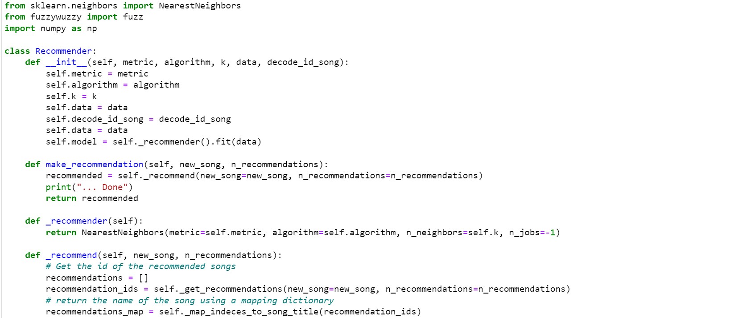

Slide 11
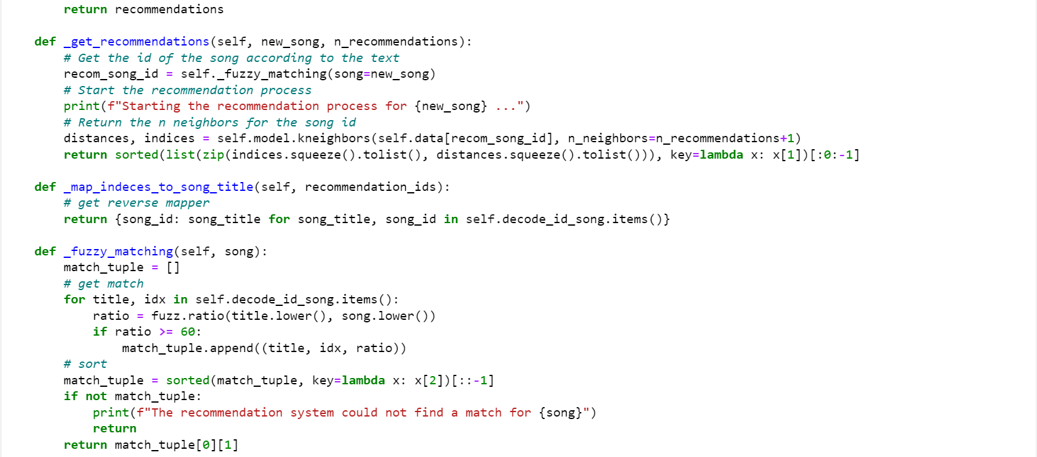

Slide 12
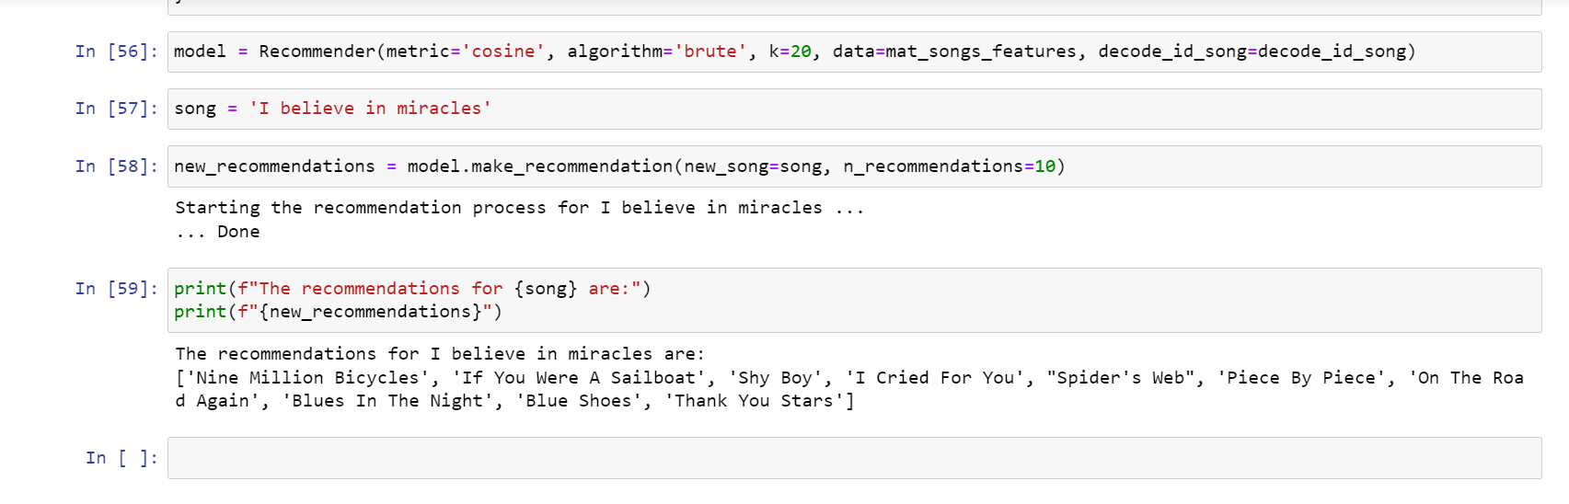

Slide 13
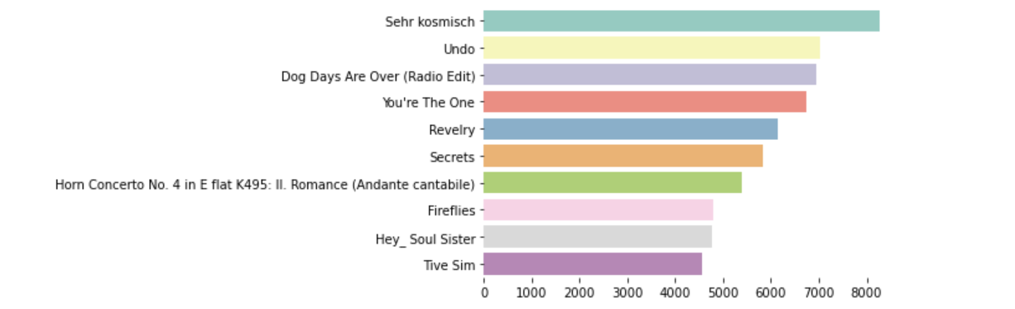
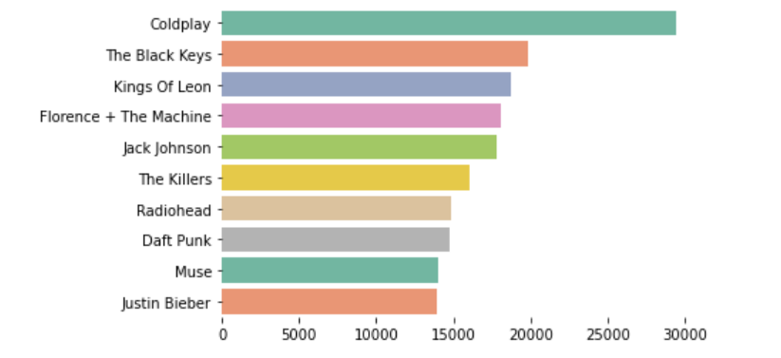

Slide 14
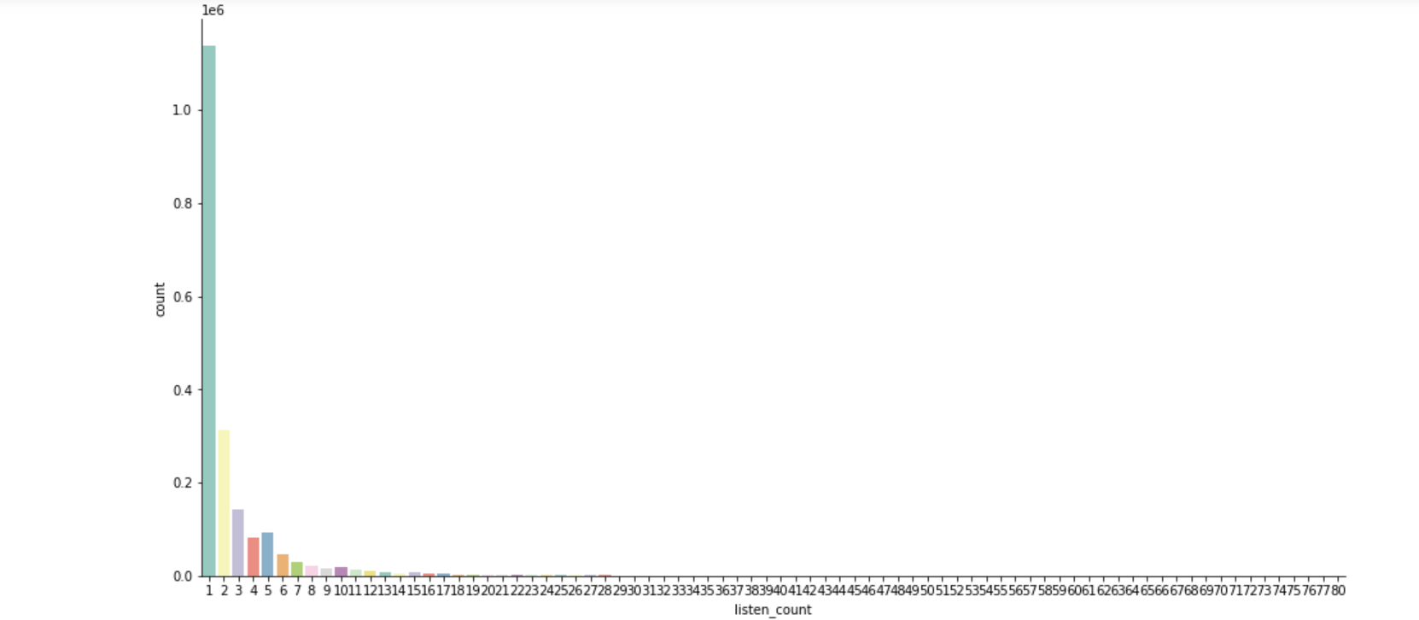

Slide 15
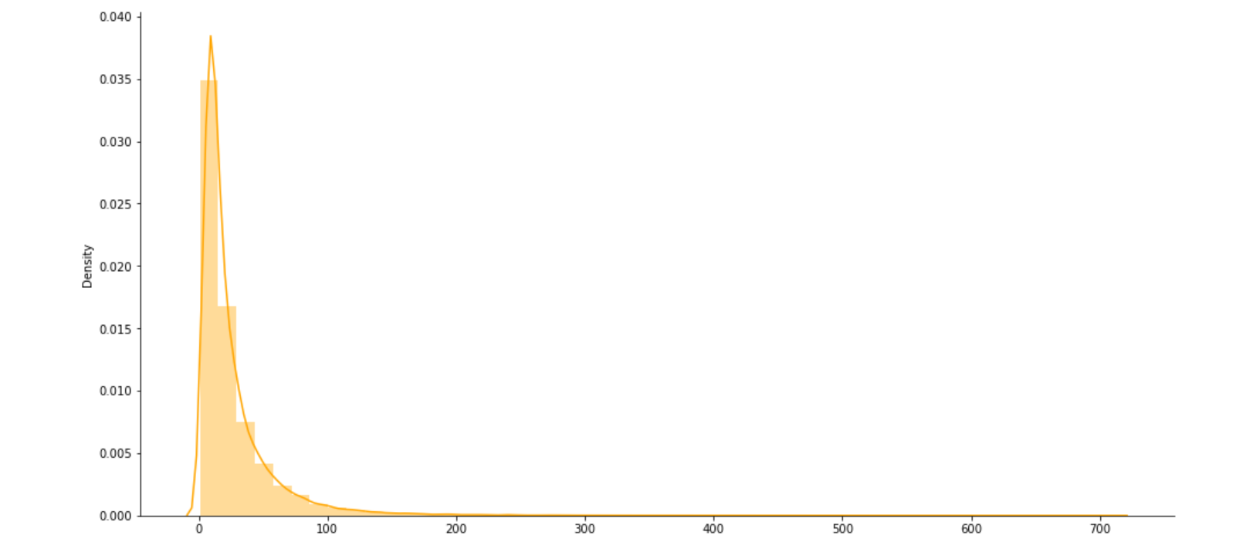

Slide 16
GITHUB LINK
https://github.com/Harshith-07/Music-recommendation-system

Slide 17
THANK YOU

